Slide 1
Competition Law & Digital Economy
Flora Stock-Kondrat
PPKA JÁK 2024/2025/2
kondratflora98@gmail.com

Slide 2
Basic concept
Competition:
Struggle or contention for superiority
Process of rivalry between firms seeking to win custmers’ business over time by offering them a better deal
Competition law:
Give effect to economic and competition policy
Legal framework that enforces CP
CP > Antitrust
Competition policy:
Public policy to protect competition
Central concern of CL and CP: firm(s) can harm competition where they possess market power
Cases: Standard Oil, AT&T, Microsoft

Slide 3
Why is competition good?
Benefits:
Lower prices
Greater efficiency
Better products (ie.: higher quality)
Innovation: new products, technologies, method of production
Wider choice for consumers
But:
Perfect competition is based on assumptions
Not a panacea to cure all problems
Agreements to restrict competition may be benefitial

Slide 4
Perfect competition
infinite number of buyers and sellers
products are identical/ homogeneous
consumers have perfect information about market conditions
no ’barriers to entry’
no ’barriers to exit’
no transport/ search / other switching costs for consumers
Society’s wealth overall is maximised
Allocative and productive efficiency will be achieved + dynamic efficiency

Slide 5
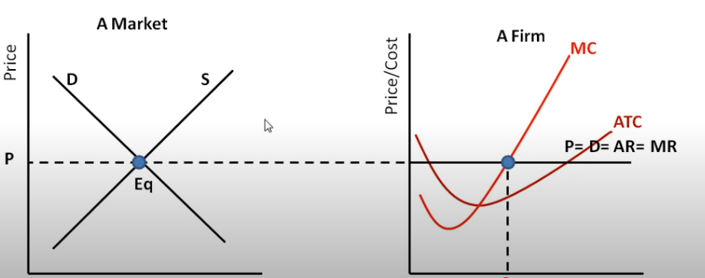

Slide 6
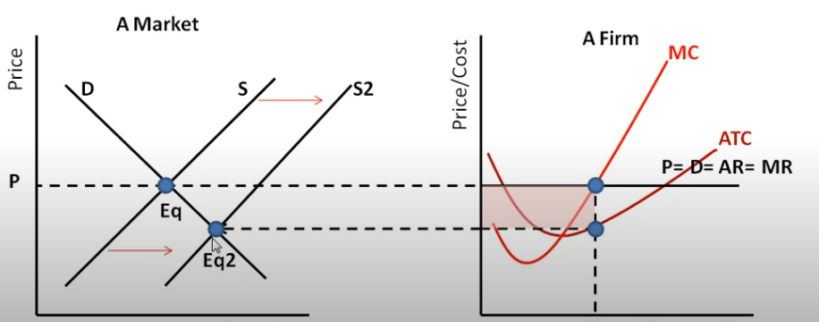

Slide 7
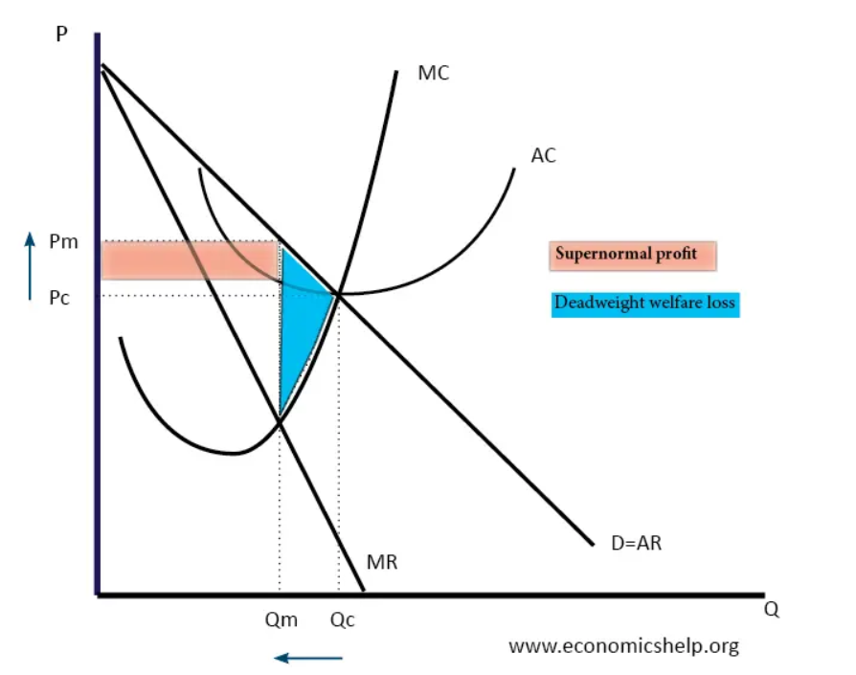
Monopoly (as a market structure)
Against:
Reduce consumer choice
Higher price
Low quality
Excessive profit
→Deadweight loss of society
Pro:
Achive economies of scale: goods could be offered on a lower price
Dinamic efficiency (R&D)
Contestable market: no barriers to entry
Natural monopolies: oil, gas, universalservice obligations as mail
Dominant =/= Monopoly
Network effects and tipping

Slide 8
Market definition and market power
Market power = the real question
The ability of one or more firms profitably to raise prices over a period of time, or to behave analogously
that enables the undertaking to behave independently on the market (substantial market power)
Market definition = framework for the assessment
Mario Monti: „… a cornerstone of competition policy, but not the whole building”

Slide 9
When it is necessary?
1.a. restricting competition or effect on trade between MSs (Art. 101(1))
1.b. substantially eliminate competition(Art.101(3)b)
1.c. block exemptions
2. dominant position (Art.102)
3. significantly impede effective competition
1. anti-competitive agreements
2. abuse of substantial market power
3. mergers
4. public restrictions of competition
5. state aid

Slide 11
Role of market definition
Competitive constraint:
Demand substitution
Supply substitution
Potential competition
Relevant markets:
Relevant product market
Relevant geographical market
* Temporal dimension: seasonality

Slide 12
Relevant product market
Relevant geographic market

Slide 13
Competition constraints
Demand substitution (!): whether and to what extent consumers can easily switch from one product to another
Substitute products – the relevant market includes all these identified products
Hypothetical Monopolist Test – monopolies the widest market possible
SSNIP test: Small but Significant Non-transitory Increase in Price
5-10 %
SSNDQ: Small but Significant Decrease in Quality
Supply substitution: the suppliers are able to switch production between products while incurring only insignificant additional sunk costs or risks

Slide 14
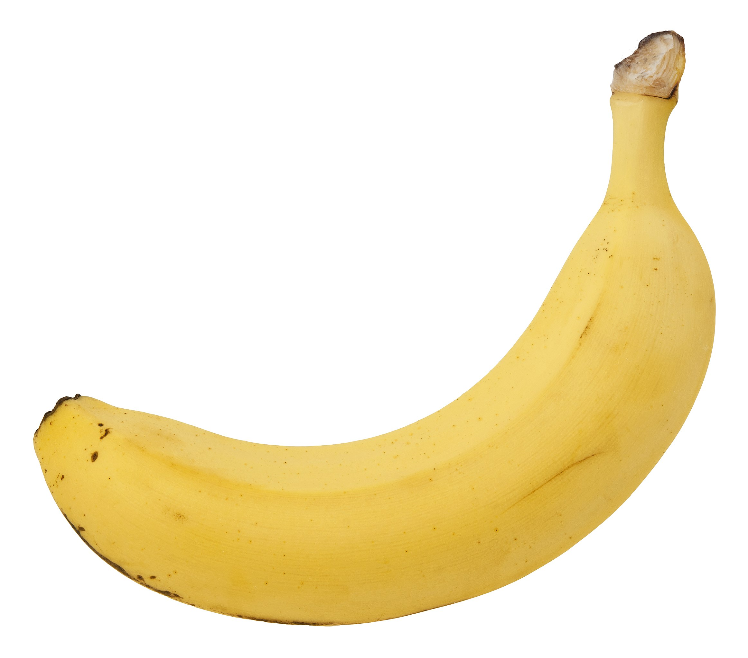
Relevant product market
Interchangeability
Case: United Brands v. Commission (1978)
Green banana clause
Cross elasticity of demand (XED)
Case: Cellophane Fallacy or Paradox (1956)

Slide 15
2025.03.03.

Slide 16
Summary of the last lecture
Why is competition good?
Perfect competition v. Monopoly as a market structure
Market power
Market definition:
Relevant product market
Relevant geographic market
Competitive constrains

Slide 17
Sherman Act (1890)
15 U.S. Code § 1 - Trusts, etc., in restraint of trade illegal; penalty
„Every contract, combination in the form of trust or otherwise, or conspiracy, in restraint of trade or commerce among the several States, or with foreign nations, is declared to be illegal. Every person who shall make any contract or engage in any combination or conspiracy hereby declared to be illegal shall be deemed guilty of a felony (…)”
15 U.S. Code § 2 - Monopolizing trade a felony; penalty
„Every person who shall monopolize, or attempt to monopolize, or combine or conspire with any other person or persons, to monopolize any part of the trade or commerce among the several States, or with foreign nations, shall be deemed guilty of a felony (…)”

Slide 18
EU Competition law Chapter 1 of Title VII of Part Three of the TFEU
Concerned practices | Regulation
Anti-competitive agreements | Article 101 TFEU + Regulation (EU) No. 1/2003
Abuse of substantial market power | Article 102 TFEU + Regulation (EU) No. 1/2003
Mergers | Council Regulation (EC) No 139/2004 (EUMR)
Public restrictions of competition | Article 106 TFEU
State aid | Article 107-109 TFEU

Slide 19
Who is the boss?
Appeals from the GC on points of law
Advocate General
Court of Justice
Judicial protection
Reviews legality: both law and the facts
General Court
Regulation 1/2003
Application of the Treaties
Responsible for the enforcement of Art 101-102
European Commission
*NCA

Slide 20
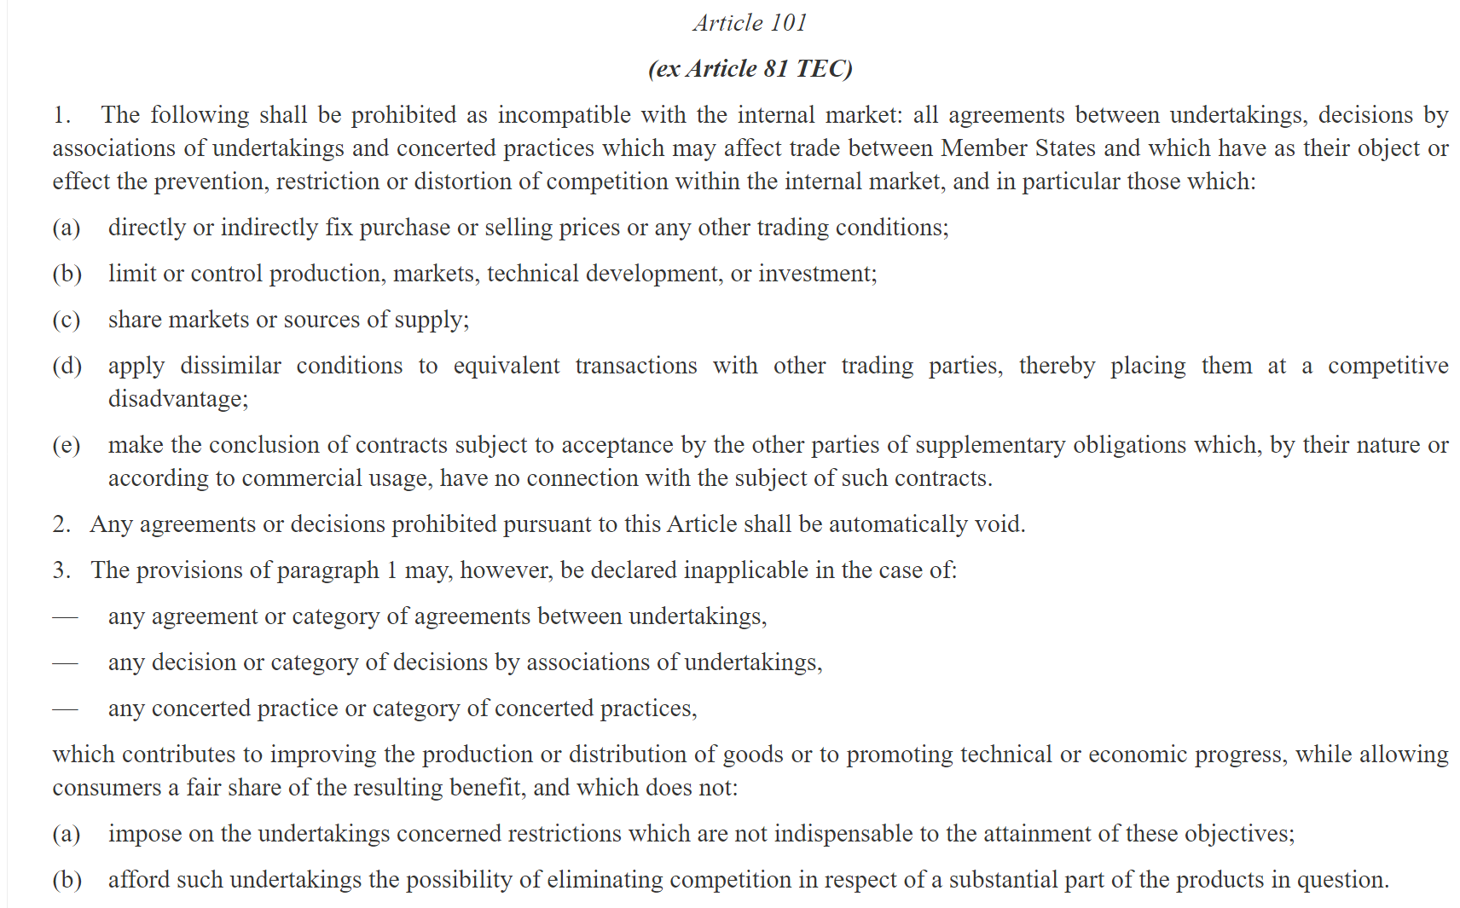

Slide 21
Article 101(1) TFEU
„The following shall be prohibited as incompatible with the internal market: all agreements between undertakings, decisions by associations of undertakings and concerted practices which may affect trade between Member States and which have as their object or effect the prevention, restriction or distortion of competition within the internal market”
Undertaking and associations of undertakings
Agreements, decisions and concerted practices
Object or effect
Affect trade between MS

Slide 22
Undertaking
Perpetrator of an infringement
Its responsibility the distortion of competition
„the concept of an undertaking encompasses every entity engaged in an economic activity regardless of the legal status of the entity and the way in which is it financed” (Höfner and Elser v Macrotron GmbH Case C-41/90)
„an activity consisting offering goods or services on a given market” (Lithuanian Chamber of Notaries Case C-128/21)
Functional approach
No need for a profit-motive or economic purpose
Legal form is irrelevant
Not economic activity: solidarity; exercise of the power of a public authority; ancillary behavior of procurement
Interesting cases: professions; employees; trade unions

Slide 23
Associations of undertakings
„…Article 101(1) covers not only direct methods of coordinating conduct between undertakings (agreements and concerned practices) but also institutionalized forms of cooperation, that is to say, situations in which economic operators act through a collective structure or a common body” (Wouters Case C-309/99)
x formally approved by a public authority
x members are appointed by the state
„act as an association” (MasterCard Inc v Commission Case C-382/12)

Slide 24
The „single economic entity” doctrine
Art 101(1) does not apply to agreements between 2 or more legal persons that form a single economic entity
„ consist of a unitary organisation of personal, tangible and intangible elements, which pursue a specific economic aim on a long-term basis” (Sumal SL v Mercedes Benz Trucks Espana SL Case C-882/19)
Collectively they comprise a single undertaking: the relationship is so close
There is no „between” – internal allocation of functions
Key case: Viho v Commission (Case T-102/92)
Subsidiaries do not enjoy real autonomy
„when a company exercises decisive influence over another company”
Parent company could be liable
Akzo (rebuttable) presumption: parent company with „all or almost all” of the shares

Slide 25
What if…?
What happens if the entity that controls an undertaking at the time of the Commissions decision is different from the entity that committed the infringement?
Successor is liable if: functional and economic continuity
What if one undertaking commits an infringement, but then sells the business that was responsible for the infringement to a third party?
If original still in existence, it remains liable, not the acquirer
But: ceased to exists or no longer economic activity → acquirer

Slide 26
Agreements
„centers around the existence of a concurrence of wills between at least two parties, the form in which it is manifested being unimportant so long as it constitutes the faithful expression of the parties' intention” (Bayer v Commission Case T-41/96)
Evidence that an agreement was concluded
x specifiy mechanism by the object was to be attained
through indicia
They are objective and consistent
Taken together, in the absence of another plausible explanation
Collusive behaviour

Slide 27
Examples of agreements
Legal contract
Trade mark delimitation agreement
Settlement of a patent action
„Gentlemen’s agreement”
A protocol
Oral agreement
Contractual terms and conditions in a standard-form contract
Expired agreement if the effect could still be felt
Constitution of a trade association
Guidelines
Etc.

Slide 28
Decision by associations of undertakings
Wide meaning
Acts of an association that serves to coordinate the conduct of its members or those subject to its authority
Regulations governing the operation
Recommendations that members tend to comply
Does not matter if not bindig

Slide 29
Concerted practices
Conduct which is not attributable to an agreement or a decision, but may amount to an infringement
„Coordination between undertakings which (…) knowingly substitutes practical cooperation between them for the risk of competition” (Dyestuffs case)
„Direct or indirect contact” (Sugar cartel case)
Does not need to be a plan verbally achieved
Reciprocity: „A discloses its future intentions or conduct on the market to B when B requests it or at least accepts it” (Cimenteries CBR SA v Commission Cases T-25/95)
Anic presumption of „casual connection”: after making contact, such common conduct will follow

Slide 30
The Object or Effect of Preventing, Restricting or Distorting Competition
OBJECT
EFFECT
„such coordination reveals in itself a sufficient degree of harm to competition” → reveals in itself such harm
Objective meaning and purpose
X subjective intention
By nature or so likely it is redundant to prove
Economic and legal context, functioning and structure of the market
In this case it is unnecessary to prove that it will produce anti-competitive effect
Court of Justice said so
(Resale)Price fixing, exchanges of information about price, market sharing, export bans, etc.
„Appreciable adverse impact on the parameters of competition, such as the price, the quantity and the quality of the goods or services”
Should be assessed:
The agreement/ clause
Relevant market
Theory of harm
Counterfactuals: the actual context in which the competition would occur in the absence of the agreement
Available evidence

Slide 31
Defence
There is no per se rule or rule of reason in EU law
Objective necessity: the agreement or the restrictive clauses in it were objectively necessary to achieve a legitimate purpose
The Wouters doctrine: non-competition objectives
Article 106(2): Undertakings entrusted with the operation of services of general economic interest or having the character of a revenue-producing monopoly shall be subject to the rules…insofar the rules does not obstruct the performance, in law or in fact, of the particular tasks assigned to them
State compulsion defense: they are compelled by law to behave in a particular way
Highly regulated markets: legal framework leaves no possibility for competitive activity

Slide 32
Trade between Member States
The inter-Member State trade clause: sets the boundary between the areas covered by EU law and domestic law
„may affect”:
Possible to foresee
With a sufficient degree of probability
On the basis of objective factors of law or fact
Agreement may have an influnce (direct or indirect; actual or potential)
Must be appreciable
SMEs businesses
Aggregated market share below 55 and turnover below 40 million EUR
Article 101 and 102 are capable of application irrespective of where the undertakings concerned are located, provided that the agreement/ practice is implemented or has effects within the EU

Slide 33
De Minimis Doctrine
Key case: Völk v Vervaecke (Case 5/69)
The agreement „do not have an appreciable impact either on inter-state trade or on competition”
Safe harbour
Threshold:
Agreements between competitors: aggregate market share below 10%
Agreements between non-competitors: market share by each below 15%
Cumulative foreclosure effect
Does not apply to object restrictions

Slide 34
Article 101(3)
Burden of proof is on the undertaking
Any kind of agreement
Cumulative conditions:
Objective, economic substantiated advantages/ benefits
Indispensability of the restriction: the agreement and the individual restriction as well
„Pass-on” requirement
In relation to Article 102
Individual cases or block exemptions

Slide 35
2025.03.17.

Slide 36
What we covered last time?
Article 101 of the TFEU
Article 101(1)
What is an undertaking?
Undertaking, association of undertakings, single economic entity
What consitutes an agreement?
Agreement, decision, concerted practice
Has as an object or effect to restrict competition
Affect trade between Member States
Article 101(3)

Slide 37
EU Competition law Chapter 1 of Title VII of Part Three of the TFEU
Concerned practices | Regulation
Anti-competitive agreements | Article 101 TFEU + Regulation (EU) No. 1/2003
Abuse of substantial market power | Article 102 TFEU + Regulation (EU) No. 1/2003
Mergers | Council Regulation (EC) No 139/2004 (EUMR)
Public restrictions of competition | Article 106 TFEU
State aid | Article 107-109 TFEU

Slide 38
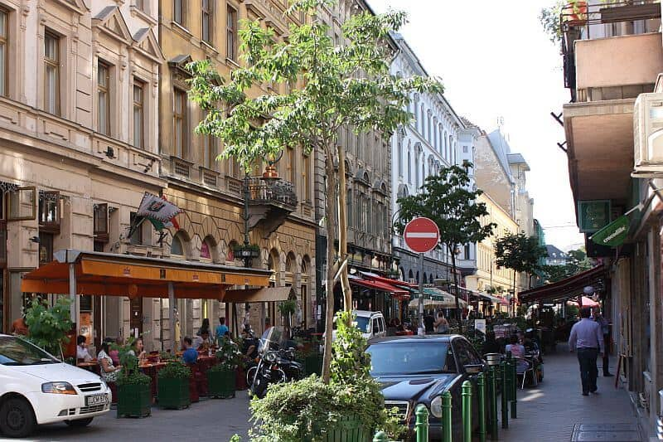
Notes:
Imagine that there are 5 ice cream shop along ráday street. Imagine that they all agree that because of the inflation, they want to set a minimum price for the ice cream. They are all near to each other, they are the only competitiors among themself in the ráday street. They are in business for many years, its a really tough year and they want everyone to have a stable business….
Now imagine that there is an ice cream cone maker company, and they are the only one to do it for budapest. All the shops get they cones from the company. now, the company sees that it is really profitable to open an ice cream shop on the ráday street – so it does. But to make its business the best, it decides to supply the cones for the other shops on an elevated price. Becasue of that, the ice cream shops have to increase the prices to keep the business profitable – but the new ice cream shop stays on the same price, because it gets the cones for the same price. On the long run, de businesses cant keep up and the only icecream shop on ráday street will be the new one – and the ice cream prices will be twice as much.

Slide 39
Article 102
Any abuse by one or more undertakings of a dominant position within the internal market or in a substantial part of it shall be prohibited as incompatible with the internal market in so far as it may affect trade between Member States.
Such abuse may, in particular, consist in:
(a) directly or indirectly imposing unfair purchase or selling prices or other unfair trading conditions;
(b) limiting production, markets or technical development to the prejudice of consumers;
(c) applying dissimilar conditions to equivalent transactions with other trading parties, thereby placing them at a competitive disadvantage; [discriminating]
(d) making the conclusion of contracts subject to acceptance by the other parties of supplementary obligations which, by their nature or according to commercial usage, have no connection with the subject of such contracts.

Slide 40
Article 102 - Elements
Act in an abusive manner
One or more undertakings
Has a dominant position
Internal market
Affect trade between MS

Slide 41
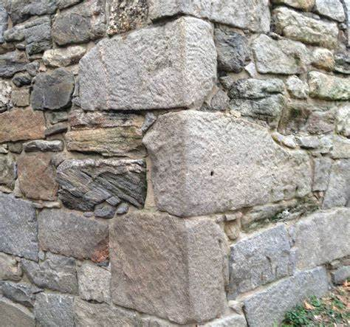
Dominant position
ECONOMIC POWER
INDEPENDENCE
„enables it to prevent effective competition maintained on the relevant market by affording it the power to behave to an appreciable extent independently of its competitors, customers and ultimately of its consumers” ( United Brands v Commission)
Binary term: yes or no

Slide 42
Dominant position – 2 step
GEOGRAPHICAL MARKET
DEFINE RELEVANT MARKET
PRODUCT MARKET
DETERMINE UNDERTAKINGS POSITION = MEASURE MARKET POWER

Slide 43
Relevant product market
Relevant geographic market

Slide 44
Dominant position – 2 step
GEOGRAPHICAL MARKET
DEFINE RELEVANT MARKET
Substantial part of the IM
PRODUCT MARKET
ACTUAL COMPETITORS – MARKET POSITIONS
DETERMINE UNDERTAKINGS POSITION = MEASURE MARKET POWER
POTENTIAL COMPETITORS – EXPANSION AND ENTRY
COUNTERVAILING BUYER POWER

Slide 45
Measure market power
Market share – good indicator
Power over time
50 % is „very large”
Super-dominance
Legal barriers (patent or know-how)
Economic advantages and performance
Switching cost and network effect
… and how the undertaking behaves

Slide 46
Abuse
Unilateral behavior →„Special responsibility” of a dominant undertaking
„objective concept”
„the undertaking… through recourse of methods different from those which condition normal competition” [Hoffmann-La Roche v Commission]
Formalism ←→ Effect analysis ←→ Naked restrictions
„Competition on the merits” + „as-efficient competitors” test (AEC)
Harm: actual or potential
Objective justification or efficiency justification is possible

Slide 47
Abuse
EXPLOITATIVE ABUSES
EXCLUSIONARY ABUSES
SINGLE MARKET ABUSES

Slide 48
Abuse
*AVC
*AAC
*ATC
NON-PRICING PRACTICES
PRICING PRACTICES
Exclusive dealing agreements
Tying
Refusal to supply
Bronner criteria: „essential facilities” - indispensability
Preferential treatment or self-preferencing
Unfair trading conditions
Others – vexatious litigation
Excessive pricing (unfair!)
Conditional rebates - conditionality
Bundling
Predatory pricing
Margin squeeze
Price discrimination
Others

Slide 49
Digital Economy
2025.03.24.

Slide 50
DIGITAL ECONOMY AND DIGITAL PLATFORMS
COMPETITION CONCERNS
REGULATION APPROACH

Slide 51
Offline / Online

Slide 52
What does „digital economy” mean?
Digital conversion of traditional economic activities driven by the internet, electronic measures and data.
Economy based on digital technologies
E-commerce
Digital platforms
Fintech
Cloud technology and AI
Big Data

Slide 53
Features – just to name a few…
Globalisation and market expansion
Innovation – all the time
Quick change and adoption needed
Dematerialization and virtualization
Efficiency and productivity
Data-driven: Personalized and useful
Hyperconnectivity
Network economy: network effects, economies of scale, switching costs, lock-in

Slide 54
The Four Industrial Revolution
Industry 1.0: steam engine and mechanization
Industry 2.0: mass production and electricity (internal combustion engine)
Industry 3.0: electronic and IT systems, automation
Industry 4.0: cyber physical systems (IoT, AI)
https://www.youtube.com/watch?v=M-01ii4zX_k
Moore’s Law: Doubles about every two years

Slide 55
Online platforms
„they recruit participants, and then sell each group of participants access to the other group of participants” (Evans & Schmalensee, 2016)
No legal consensus on possible legal definition
Multisidedness
Intermediaries to solve a transaction problem
Narrow
Broad

Slide 56
What does „platform” mean?
NON-NEUTRAL PRICE STRUCTURE
COORDINATION BETWEEN DISTINCT GROUPS
INDIRECT NETWORK EFFECTS

Slide 57
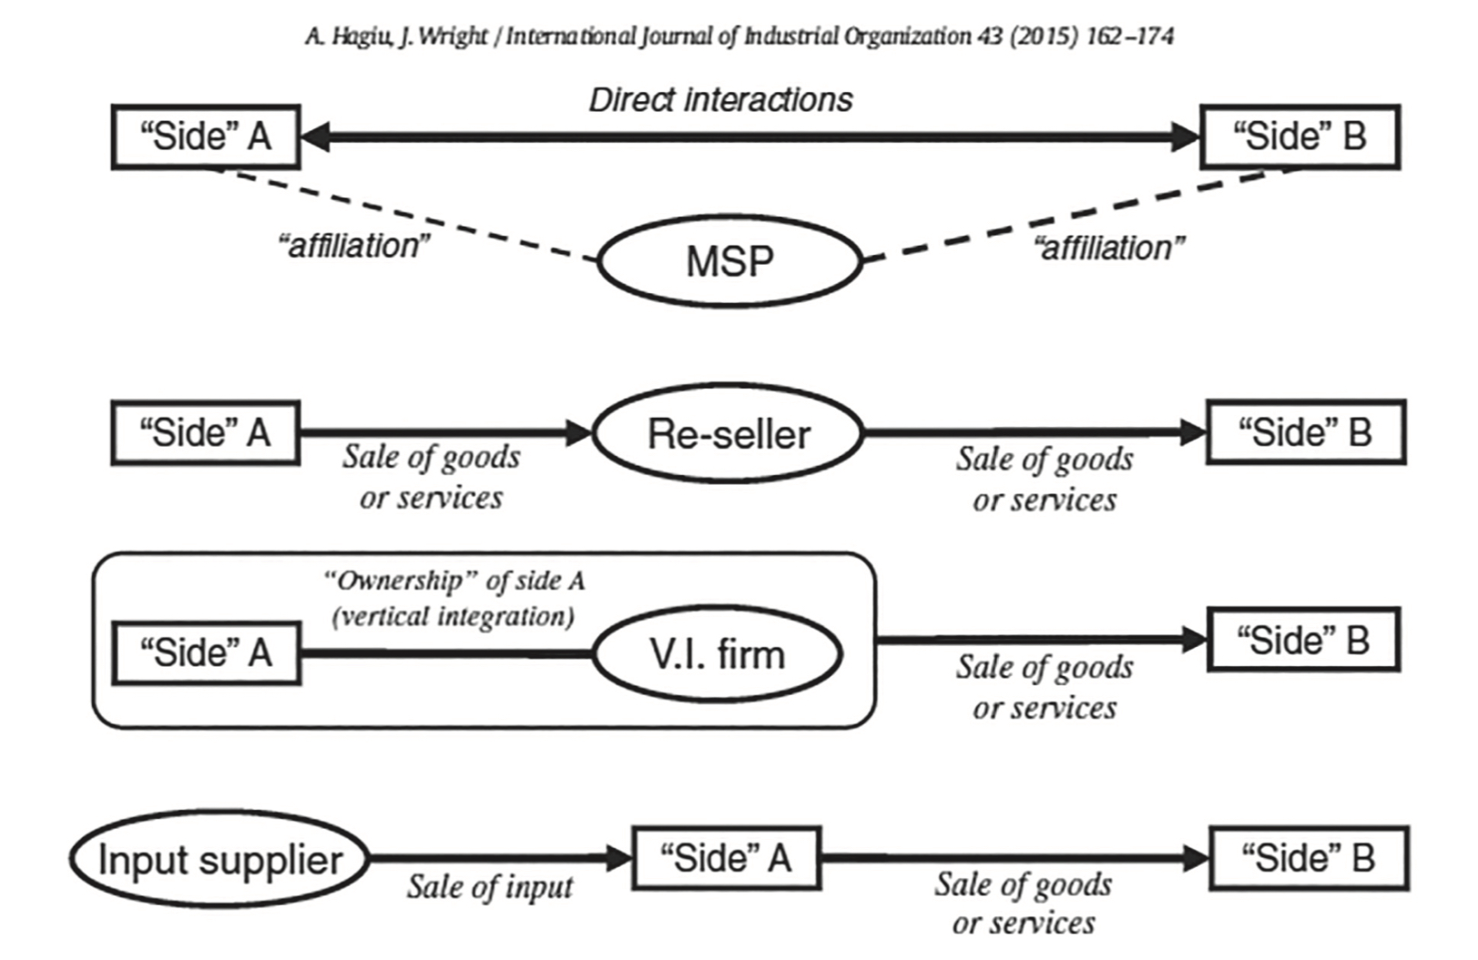

Slide 58
What does „online” mean?
Operation ONLY over the internet
Embedded to the digital infrastructure
Network economy
Higher degree of innovation

Slide 59
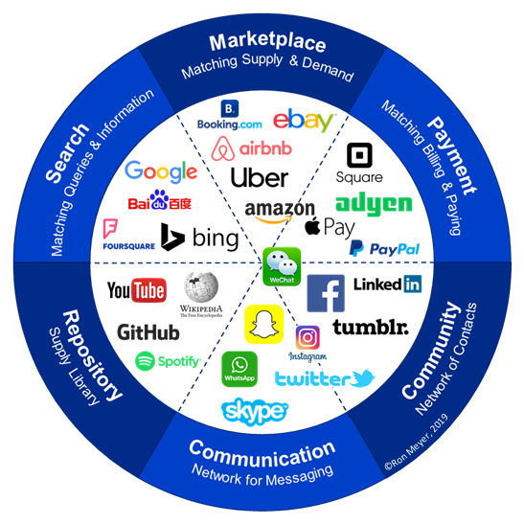

Slide 60
Do we even need a definition?

Slide 61
Platform strategy
Non-internalized, positive externalities
Externalities: effect of an economic action on an unrelated party
NOT internalized: not accounted for in the individual decisions of economic actors
Multi-product pricing strategy
Needs to achieve a „critical mass” → pick a side based on its price elasticity
Multihoming
Monetize the facilitating role: membership or usage fee
Information and incentives

Slide 62
v.
„Competition is for losers.” (Peter Thiel: From Zero to One)

Slide 63
03.31.

Slide 64
Digital economy and digital platforms
Blurry lines between offline and online world
Digital economy is economy based on digital technology
Digital platforms: ?
No consensus on legal definition
Hard to create timeless typology
Platform business strategy:
Growth-over-profit
Building an ecosystem

Slide 65
Competition concerns regarding OPs
How could some behaviors be anticompetitive?
Which part of competition law covers them?
Platform appropriation
Platform exploitation
Platform exclusion
ARTICLE 101
ARTICLE 102

Slide 66
Article 102
sine qua non
Any abuse by one or more undertakings of a dominant position within the internal market or in a substantial part of it shall be prohibited as incompatible with the internal market in so far as it may affect trade between Member States.
Such abuse may, in particular, consist in:
(a) directly or indirectly imposing unfair purchase or selling prices or other unfair trading conditions;
(b) limiting production, markets or technical development to the prejudice of consumers;
(c) applying dissimilar conditions to equivalent transactions with other trading parties, thereby placing them at a competitive disadvantage; [discriminating]
(d) making the conclusion of contracts subject to acceptance by the other parties of supplementary obligations which, by their nature or according to commercial usage, have no connection with the subject of such contracts.

Slide 67
Abuse – Platform abuses
EXCLUSIONARY ABUSES
SINGLE MARKET ABUSES
EXPLOITATIVE ABUSES
APPRORIATION

Slide 68
Platform appropriation
„the act of taking something”
Many kind of behavior: copying, scraped, „sherlock”
„Move last and take things”
…when it will be anticompetitive?
Also intellectual property law concern

Slide 70
Platform exploitation
„unjustly using something or someone for one’s own advantage or benefit, without giving fair return”
Direct harm on consumers
30% commission fee
Excessive data collection

Slide 71
Platform exclusion
Inter-platform competition: between platform
Intra-platform competition: on the platform
Important abuse category here: LEVERAGING
„(…) extending its market power into another market”
→the objective of the abusive conducts
Why?
Strategic value
Ecosystem building
When is it anticompetitive? → Incentive, ability, and effect
DEFENSIVE
OFFENSIVE

Slide 72
NON-PRICING PRACTICES
PRICING PRACTICES
Exclusive dealing agreements
Tying
Refusal to supply (e.g. disruption of supply)
Preferential treatment or self-preferencing
Unfair trading conditions
Others – vexatious litigation
Excessive pricing (unfair!)
Conditional rebates - conditionality
Bundling
Predatory pricing
Margin squeeze
Price discrimination
Others

Slide 73
Tying
Preinstallation or incompatibility

Slide 74
Refusal to supply
v.

Slide 75
Margin squeeze
30% commission fee

Slide 76
04.07.

Slide 77
Google Search (Shopping)
T-612/17.
https://curia.europa.eu/juris/liste.jsf?num=T-612/17
The Court of Justice upholds the fine of €2.4 billion imposed on Google for abuse of its dominant position by favouring its own comparison shopping service

Slide 78
Timeline
Appeals from the GC on points of law
Advocate General
Court of Justice
September, 2024
Dismissed Google’s appeal
Judicial protection
Reviews legality: both law and the facts
General Court
September 2021
Upheld the Commission’s decision
Application of the Treaties
Responsible for the enforcement of Art 101-102
European Commission
June 27, 2017
Commission decision
2009: concerned behaviors
2010: EC formal investigation

Slide 79
What is Google Shopping?
https://www.youtube.com/watch?v=1higjwEdwoU
Price comparison service

Slide 80
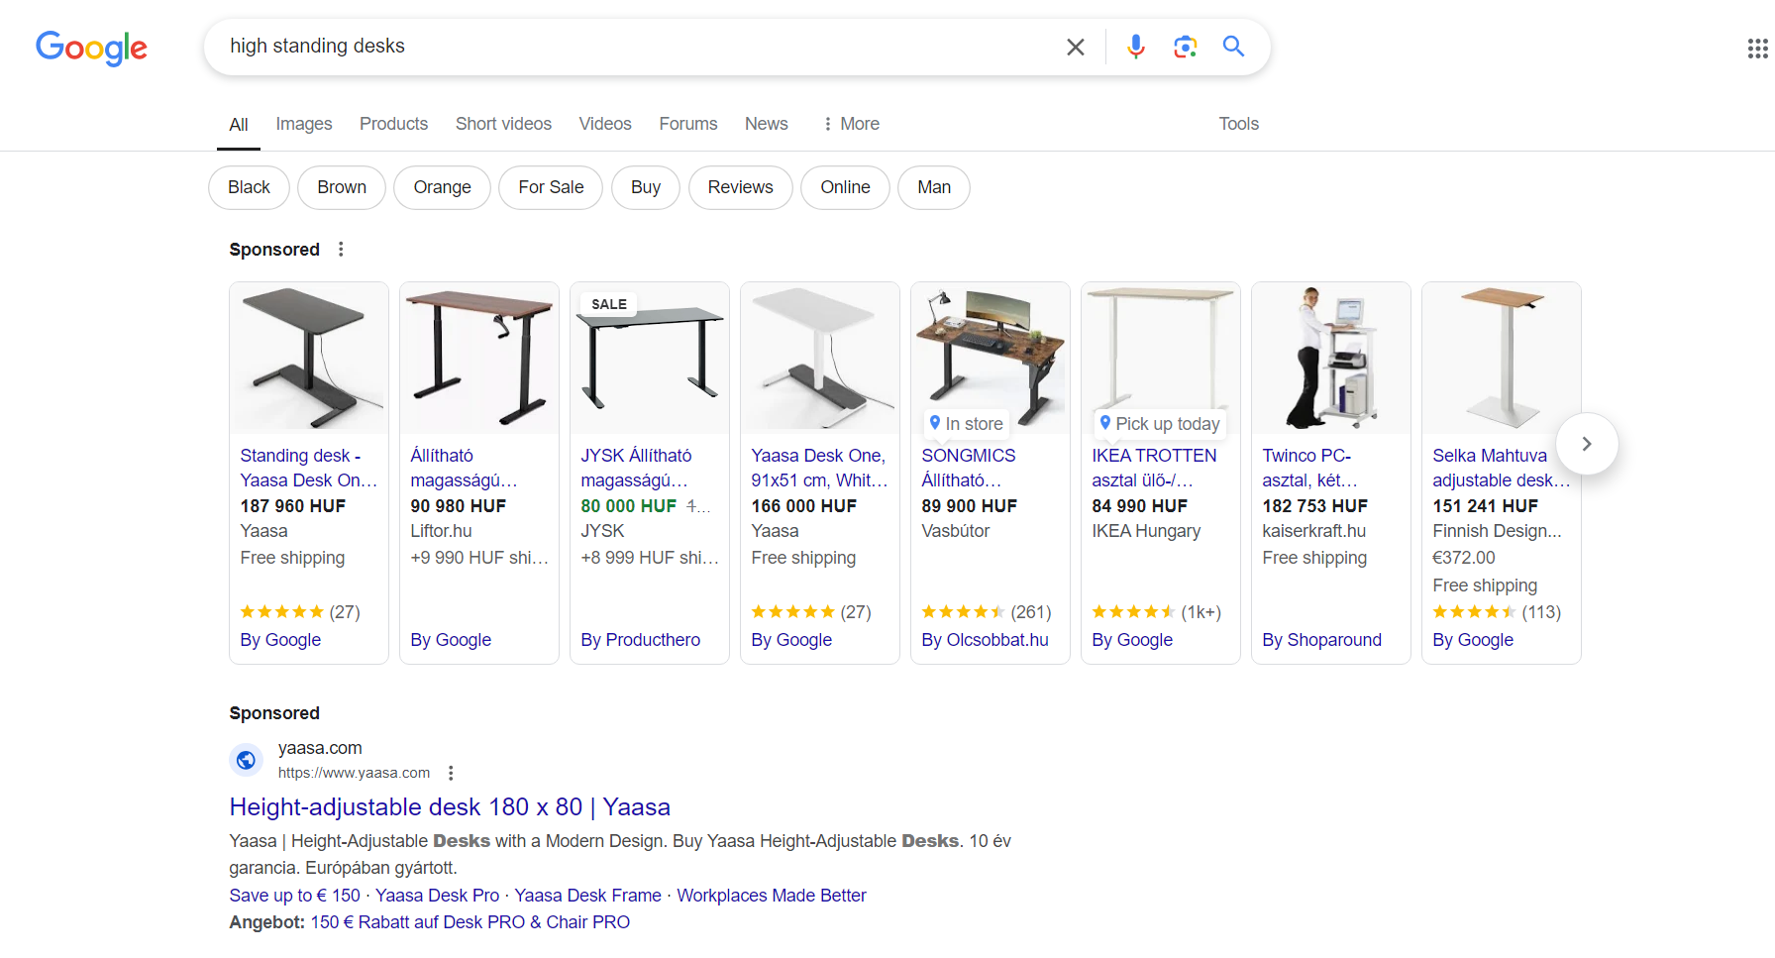

Slide 81
What kind of abuse is it then?

Slide 82
Abuse – Platform abuses
EXCLUSIONARY ABUSES
SINGLE MARKET ABUSES
EXPLOITATIVE ABUSES
APPRORIATION

Slide 83
What kind of abuse is it?
Exclusionary
Leveraging
Offensive
„What exactly are you accusing us with?”
Refusal to supply?
Discrimination? Self-preferencing?
It is abusive.

Slide 84
Questions, ground for appeal
Refusal to supply?
Oscar Bronner case: used as a defence
Really hard to prove that what is „indispensiable”
Competition on the merits
Special curcomstances
Consumer behavior
Traffic that was deluted
Superdominant
Anti-competitive effect
Counterfactuals
Causation
As-efficient-competitor test

Slide 86
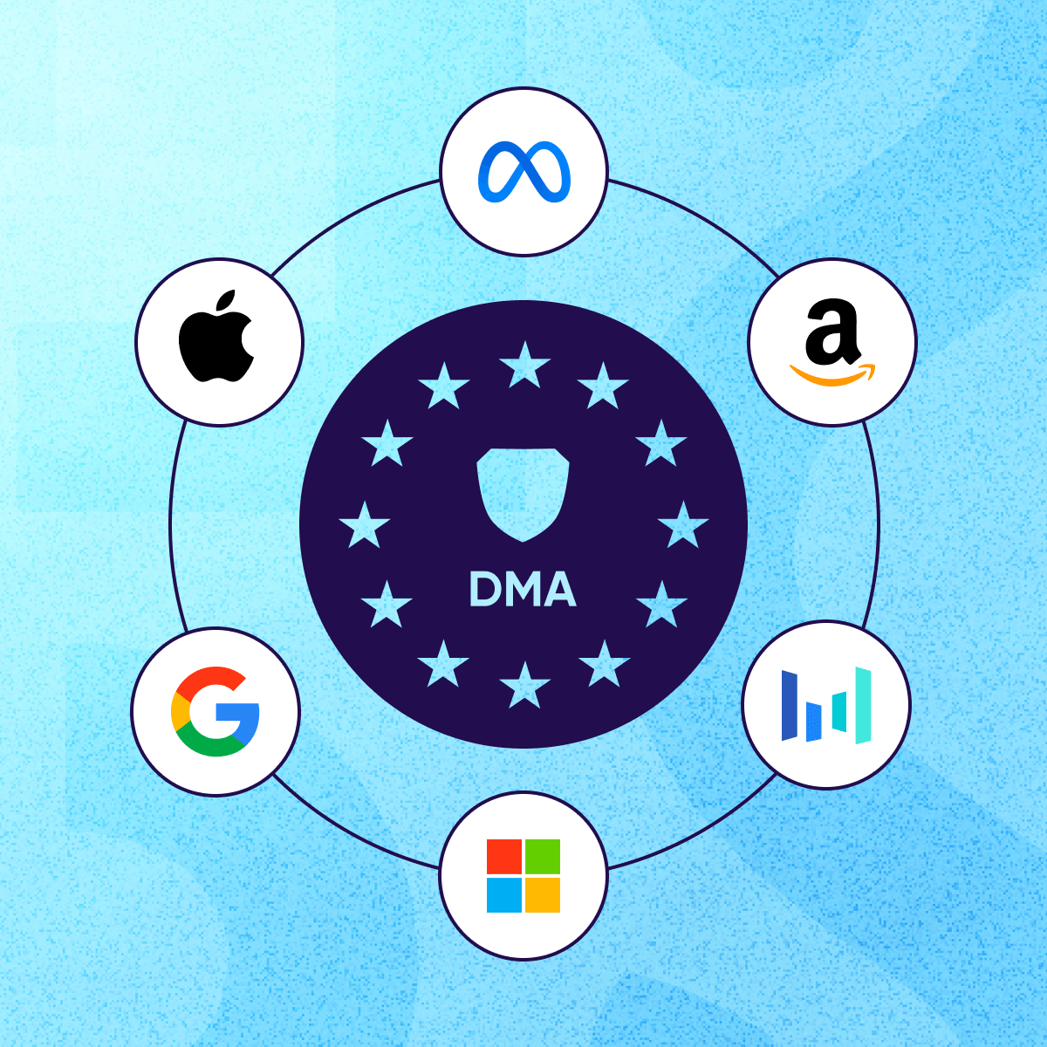
Digital Markets Act
Contestable and fair markets in the digital sector
Gatekeeper + core platform service + EU link
Procedure law nature
Participative antitrust (Regulatory sandbox)

Slide 87
Recital (5) of the DMA
(5) | It follows that the market processes are often incapable of ensuring fair economic outcomes with regard to core platform services. Although Articles 101 and 102 of the Treaty on the Functioning of the European Union (TFEU) apply to the conduct of gatekeepers, the scope of those provisions is limited to certain instances of market power, for example dominance on specific markets and of anti-competitive behaviour, and enforcement occurs ex post and requires an extensive investigation of often very complex facts on a case by case basis. Moreover, existing Union law does not address, or does not address effectively, the challenges to the effective functioning of the internal market posed by the conduct of gatekeepers that are not necessarily dominant in competition-law terms.

Slide 88
Recital (10) of the DSA
(10 | ) At the same time, since this Regulation aims to complement the enforcement of competition law, it should apply without prejudice to Articles 101 and 102 TFEU, to the corresponding national competition rules and to other national competition rules regarding unilateral conduct that are based on an individualised assessment of market positions and behaviour, including its actual or potential effects and the precise scope of the prohibited behaviour, and which provide for the possibility of undertakings to make efficiency and objective justification arguments for the behaviour in question, and to national rules concerning merger control. However, the application of those rules should not affect the obligations imposed on gatekeepers under this Regulation and their uniform and effective application in the internal market

Slide 89
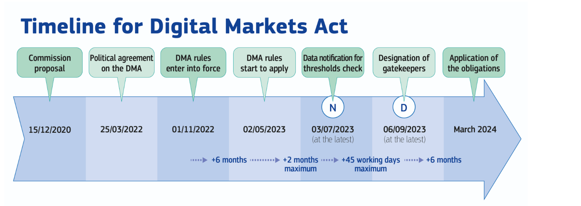

Slide 90
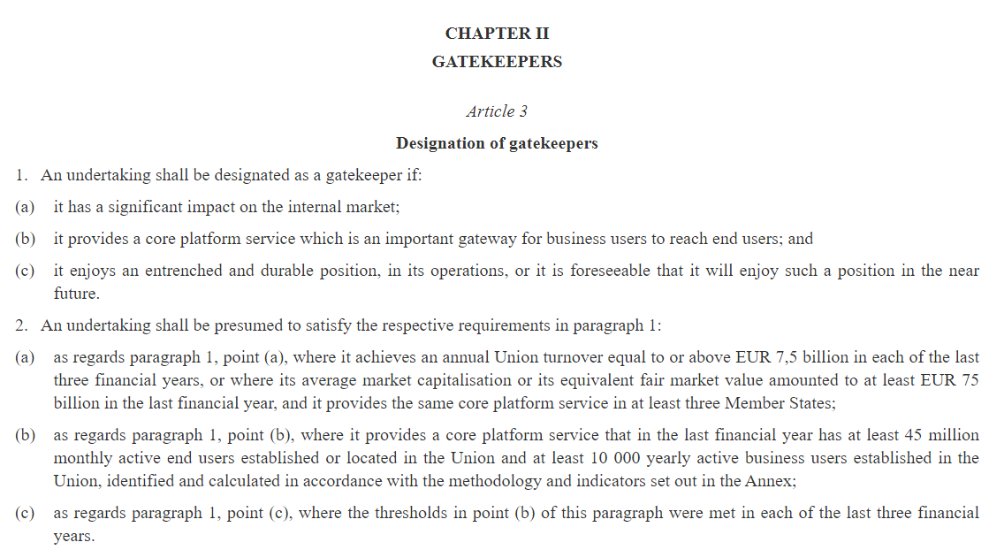
Gatekeepers

Slide 91
Article 2 of the DMA: (2) ‘core platform service’ means any of the following:
(a) | online intermediation services;
(b) | online search engines;
(c) | online social networking services;
(d) | video-sharing platform services;
(e) | number-independent interpersonal communications services;
(f) | operating systems;
(g) | web browsers;
(h) | virtual assistants;
(i) | cloud computing services;
(j) | online advertising services, including any advertising networks, advertising exchanges and any other advertising intermediation services, provided by an undertaking that provides any of the core platform services listed in points (a) to (i);

Slide 92
https://digital-markets-act.ec.europa.eu/gatekeepers_en

Slide 93
Gatekeepers obligations (Article 5-7)
Competition Law Case | Issue in the Case | Related DMA Article | DMA Provision
Facebook (Meta) Bundling Case (Germany, 2019) | Combining user data across services without consent | Art. 5(2) | Consent required for combining data across services
Apple vs. Spotify (ongoing) | Restrictions on app developers using or informing about alternative payment methods | Art. 5(4) | Gatekeepers must allow promotion and use of alternative channels
Android Case (Google, 2018) | Tying Google services (e.g., Chrome, Search) to Android OS licensing | Art. 5(9) and Art. 6(3) | No tying of services; uninstallation must be allowed
Amazon Marketplace Investigations (2020) | Use of non-public data from business users to compete against them | Art. 6(2) | No use of third-party business data to compete
Microsoft Internet Explorer (2009) | Bundling of browser with Windows OS | Art. 6(3) | Allow uninstallation of pre-installed apps
Google Shopping (2017) | Self-preferencing of Google's own services in search results | Art. 6(5) | No self-preferencing in rankings

Slide 94
Investigations
Alphabet
Apple
Meta
Self-Preferencing in Google Search
Restrictions on App Developers in Google Play
App Store Steering Rules (hinder developers from informing users about alternative purchasing options)
Core Technology Fee (€0.50 fee per app installation)
"Pay or Consent" Advertising Model

