Slide 1
Why or why not to participate? Some social and political considerations of public participation
Jávor, Benedek
Pázmány Péter Catholic University, Dept. of Environmental Law
Environmental Democracy Conference, Budapest, 19th, Oct. 2012

Slide 2
Jávor, B.: Why or why not to participate?
Public participation: "bottom-up” participatory processes over and beyond traditional “top-down” approaches to the exercise of power have globally drawn increasing interest in recent decades
Diverse areas: environmental impact assesment, local development, forestery, science and technology, public health care, etc
Different levels: local, national, global
Participatory revolution (John Dryzek)

Slide 3
Jávor, B.: Why or why not to participate?
Hungary – a contradictory case
Our previous studies:
Acceptable legal environment (BUT: negative trends)
Weak civil society
Resistance from the institutional size
Passivity among citizens

Slide 4
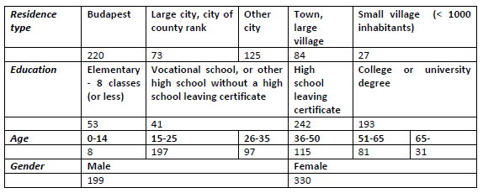
Jávor, B.: Why or why not to participate?
Present survey:
529 questionnaire
Sampling conducted in February-April, 2011
Participation of university students
Random selection of respondents (not representative sample!)
Informative cross-section of Hungarian society (age, residence type, education, gender)
SPSS programme used
Some demographic characteristics of the sample (Σ: 529)

Slide 5
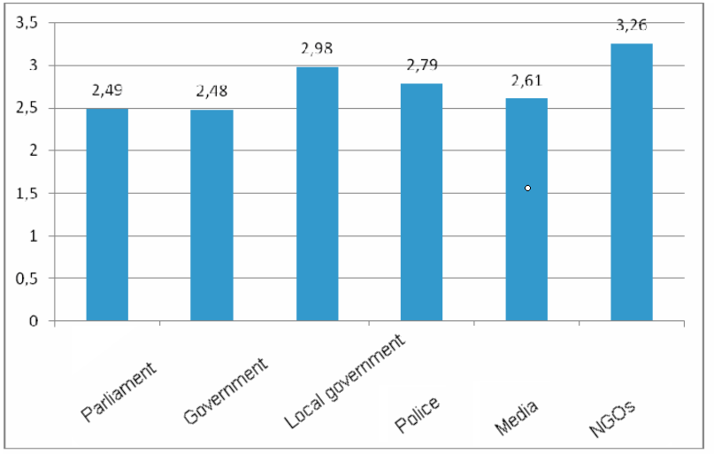
Jávor, B.: Why or why not to participate?
RESULTS
I. Trust and participation:
Low level of trust in institutions of representative democracy
Higher confidence in NGOs

Slide 6
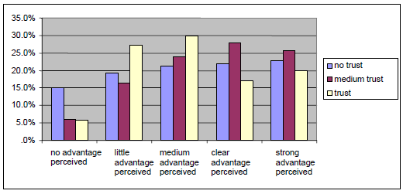
Jávor, B.: Why or why not to participate?
No linear correlation of trust in institutions and support of public participation!

Slide 7
Jávor, B.: Why or why not to participate?
Openness towards participatory processes is not uniquely generated by low levels of trust in the institutions of the state or by looking for alternatives to them;
Certain level of confidence is a precondition of participation;
Too strong belief in official institutions decrease the support of participatory processes;
Social participation is mostly considered beneficial by those who have a medium level of trust.

Slide 8
Jávor, B.: Why or why not to participate?
Clusters:
3 groups:
great trust in the system of institutions and also active in social processes:
INTEGRATED group (137)
low values over both segments: they do not trust the system of institutions and they also do not participate in social life
SCEPTICS group (330)
no trust in the system of institutions, but having an extended scope of social activities
AUTONOMOUS group (45)

Slide 9
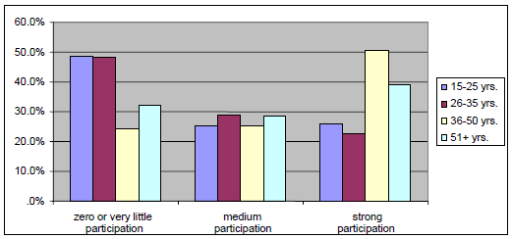
Jávor, B.: Why or why not to participate?
II. Age distribution
Traditonal view:
elderly generations’ had „bad” socialization in communist era;
younger generations are more open-minded, and active in democratic activities

Slide 10
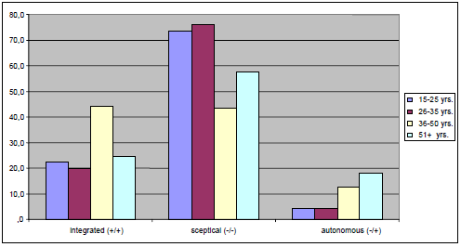
Jávor, B.: Why or why not to participate?
Clusters and age

Slide 11
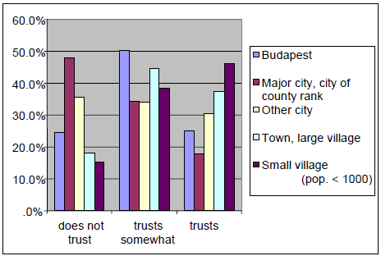
Jávor, B.: Why or why not to participate?
III. The impact of the place of residence
Different attitudes, different activities
Trust vested in local governments according to type of locality

Slide 12
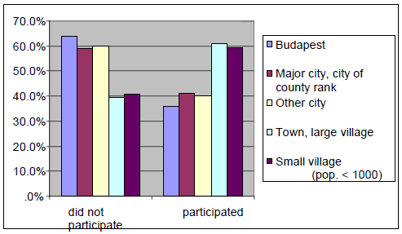
Jávor, B.: Why or why not to participate?
Correlation between participation in residential/community work and place of residence

Slide 13
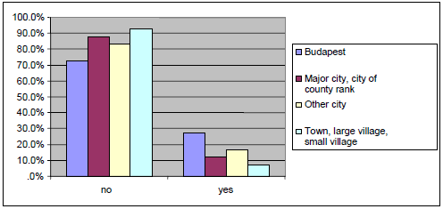
Jávor, B.: Why or why not to participate?
I
Correlation between participation in NGO protest and place of residence

Slide 14
Jávor, B.: Why or why not to participate?
In smaller settlements preference for
more direct,
more constructive solutions,
based on personal relationships
eg. residents’ forums, public hearings, participation in community work
In larger localities emphasis on
more institutionalized,
impersonal forms
that tend to focus on differences of opinion and protests
eg. citizens' protests, local referenda etc.

Slide 15
Jávor, B.: Why or why not to participate?
IV. From intention to action
Clusters: 3 groups
Those who desire action and also do engage in it:
REALIZERS group (80)
Those with low values according to both variables:
INDIFFERENTS group (264)
Those who scaled high according to 'desired action’, but they participate in few activities:
POWERLESS group (185)

Slide 16
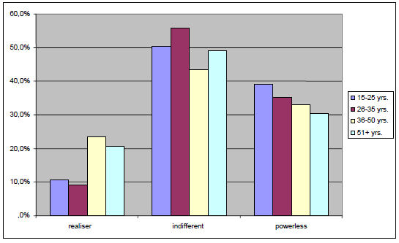
Jávor, B.: Why or why not to participate?
Distribution of the three clusters according to age groups

Slide 17
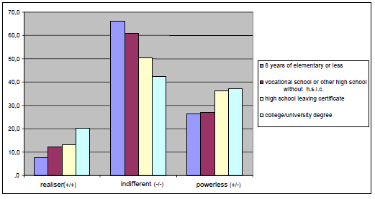
Jávor, B.: Why or why not to participate?
Distribution of the three clusters according to level of education

Slide 18
Jávor, B.: Why or why not to participate?
What are the main obstacles of active participation?

Slide 19
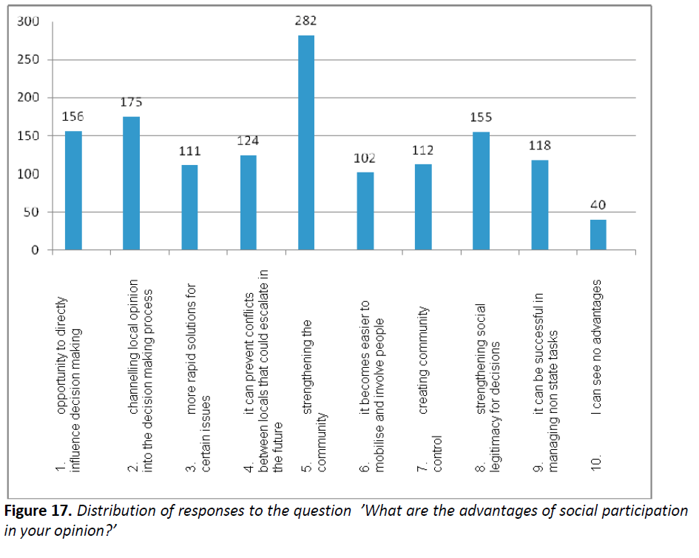
Jávor, B.: Why or why not to participate?
V. Advantages and disadvantages

Slide 20
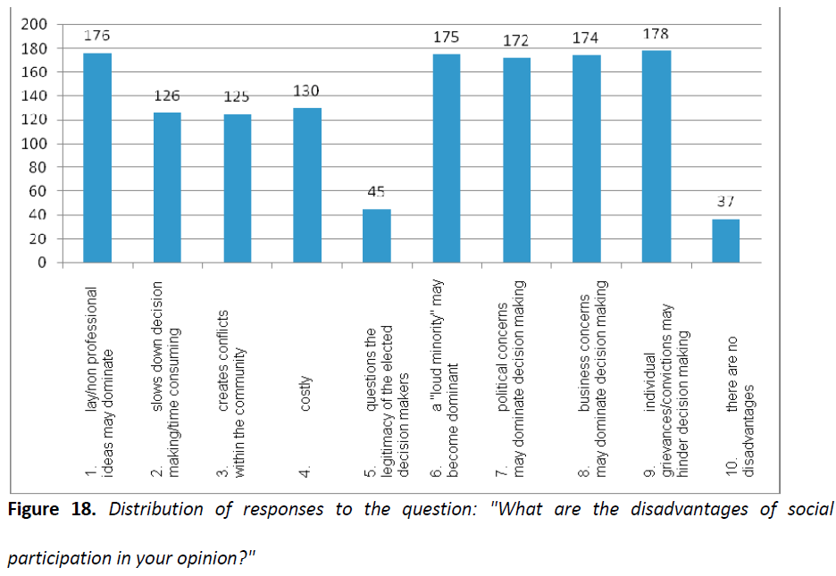
Jávor, B.: Why or why not to participate?

Slide 21
Jávor, B.: Why or why not to participate?
Conclusion:
Trust in institution of representative democracy (government, parliament, municipality) is significantly lower than that of the institutions of participative democracy (NGOs)
Middle level of confidence supports the most the willingness to participate in decisonmaking
There are NOT „badly” socialized elderly generations: younger age groups are much more sceptic and passive in every dimension. A deep crisis of democratic values!

Slide 22
Jávor, B.: Why or why not to participate?
Conclusion:
Differences in attitudes and supported participatory methods between cities and smaller settlements
Passivity, ignorance and the feeling of being powerless is widespread all over the society
Primary benefit of participation in a society of deep crisis of trust and confidence: strengthening the community
Fear of different types of manipulation in participatory procedures is common

Slide 23
Jávor, B.: Why or why not to participate?
Thank you for you attention!

